Slide 1
refnx – reproducible neutron + X-ray reflectometry analysis
Andrew Nelson
ISIS 2021 NR training school

Slide 2
In a nutshell
Python based / Open-source / Fast / Well tested
Co-refinement of Neutron, X-ray (and ellipsometry) data
Scriptable/Jupyter notebooks - reproducible research
Standalone GUI
Bayesian analysis framework – posterior distribution for parameters, model selection, include prior knowledge in modelling system {nested sampling, MCMC}
Different fitting algorithms – differential evolution, Levenberg-Marquardt, etc
Batch Fitting
Parallelisable on cluster
MixedReflectModel – model patchy surfaces
Component - defines subset of SLD profile, uses physically relevant parameters
Interface – different types of roughness between Component
Various types of resolution smearing
Simulate NR datasets

Slide 3
Sources of Information
Source code - https://github.com/refnx/refnx
Issues, Contribute your changes
Documentation - https://refnx.readthedocs.io/en/latest/
Getting Started, FAQs, Examples, API reference, etc
Video tutorials - https://www.youtube.com/channel/UCvhOxwZsdFMGqSzasE0ZSOw
User contributed models/Component - https://github.com/refnx/refnx-models
ASK

Slide 4
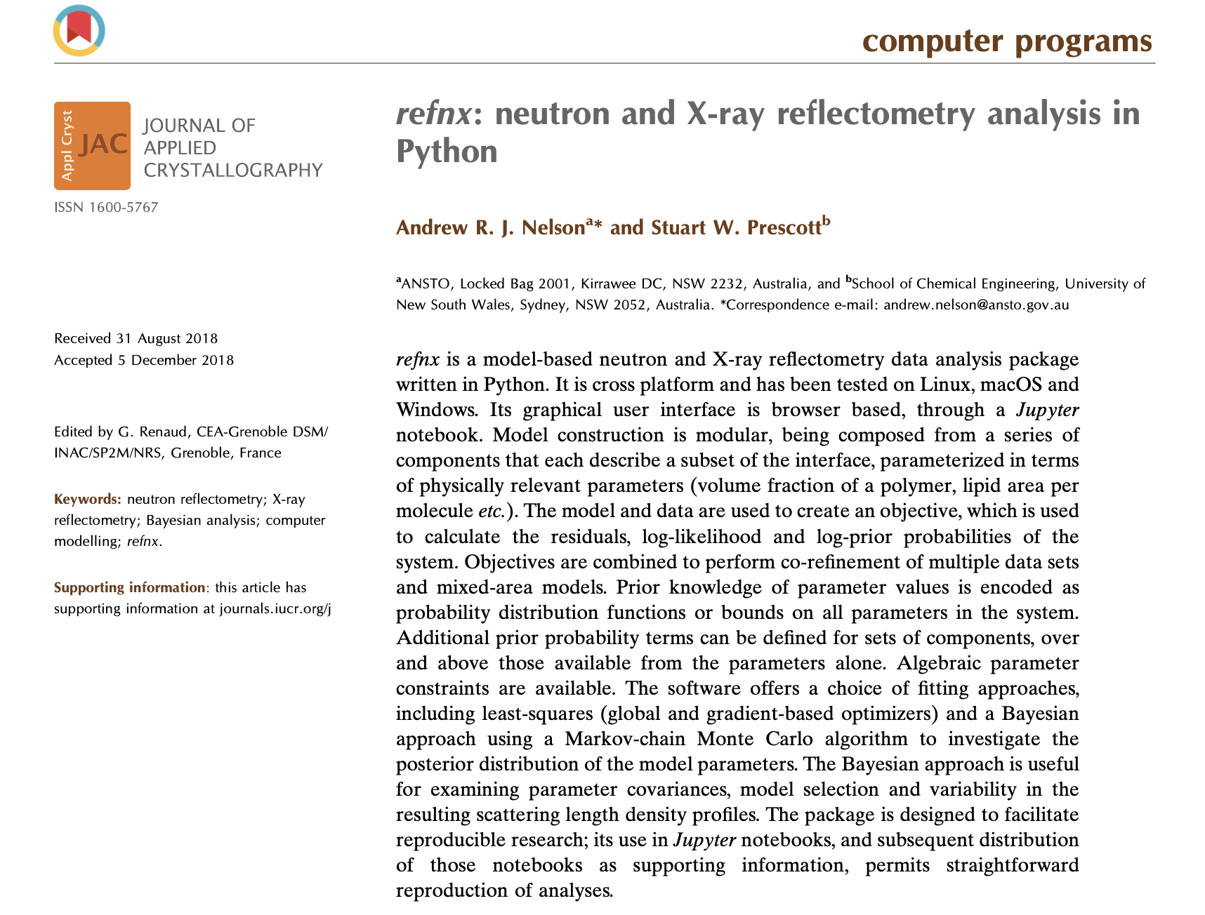
The paper
refnx paper - Nelson, A. R. J., & Prescott, S. W. (2019). refnx: neutron and X-ray reflectometry analysis in Python. Journal of Applied crystallography, 52(1), 193-200 https://doi.org/10.1107/S1600576718017296

Slide 5
How to install
pip install refnx
conda install –c conda-forge refnx
Standalone GUI - https://github.com/refnx/refnx/releases/latest

Slide 6
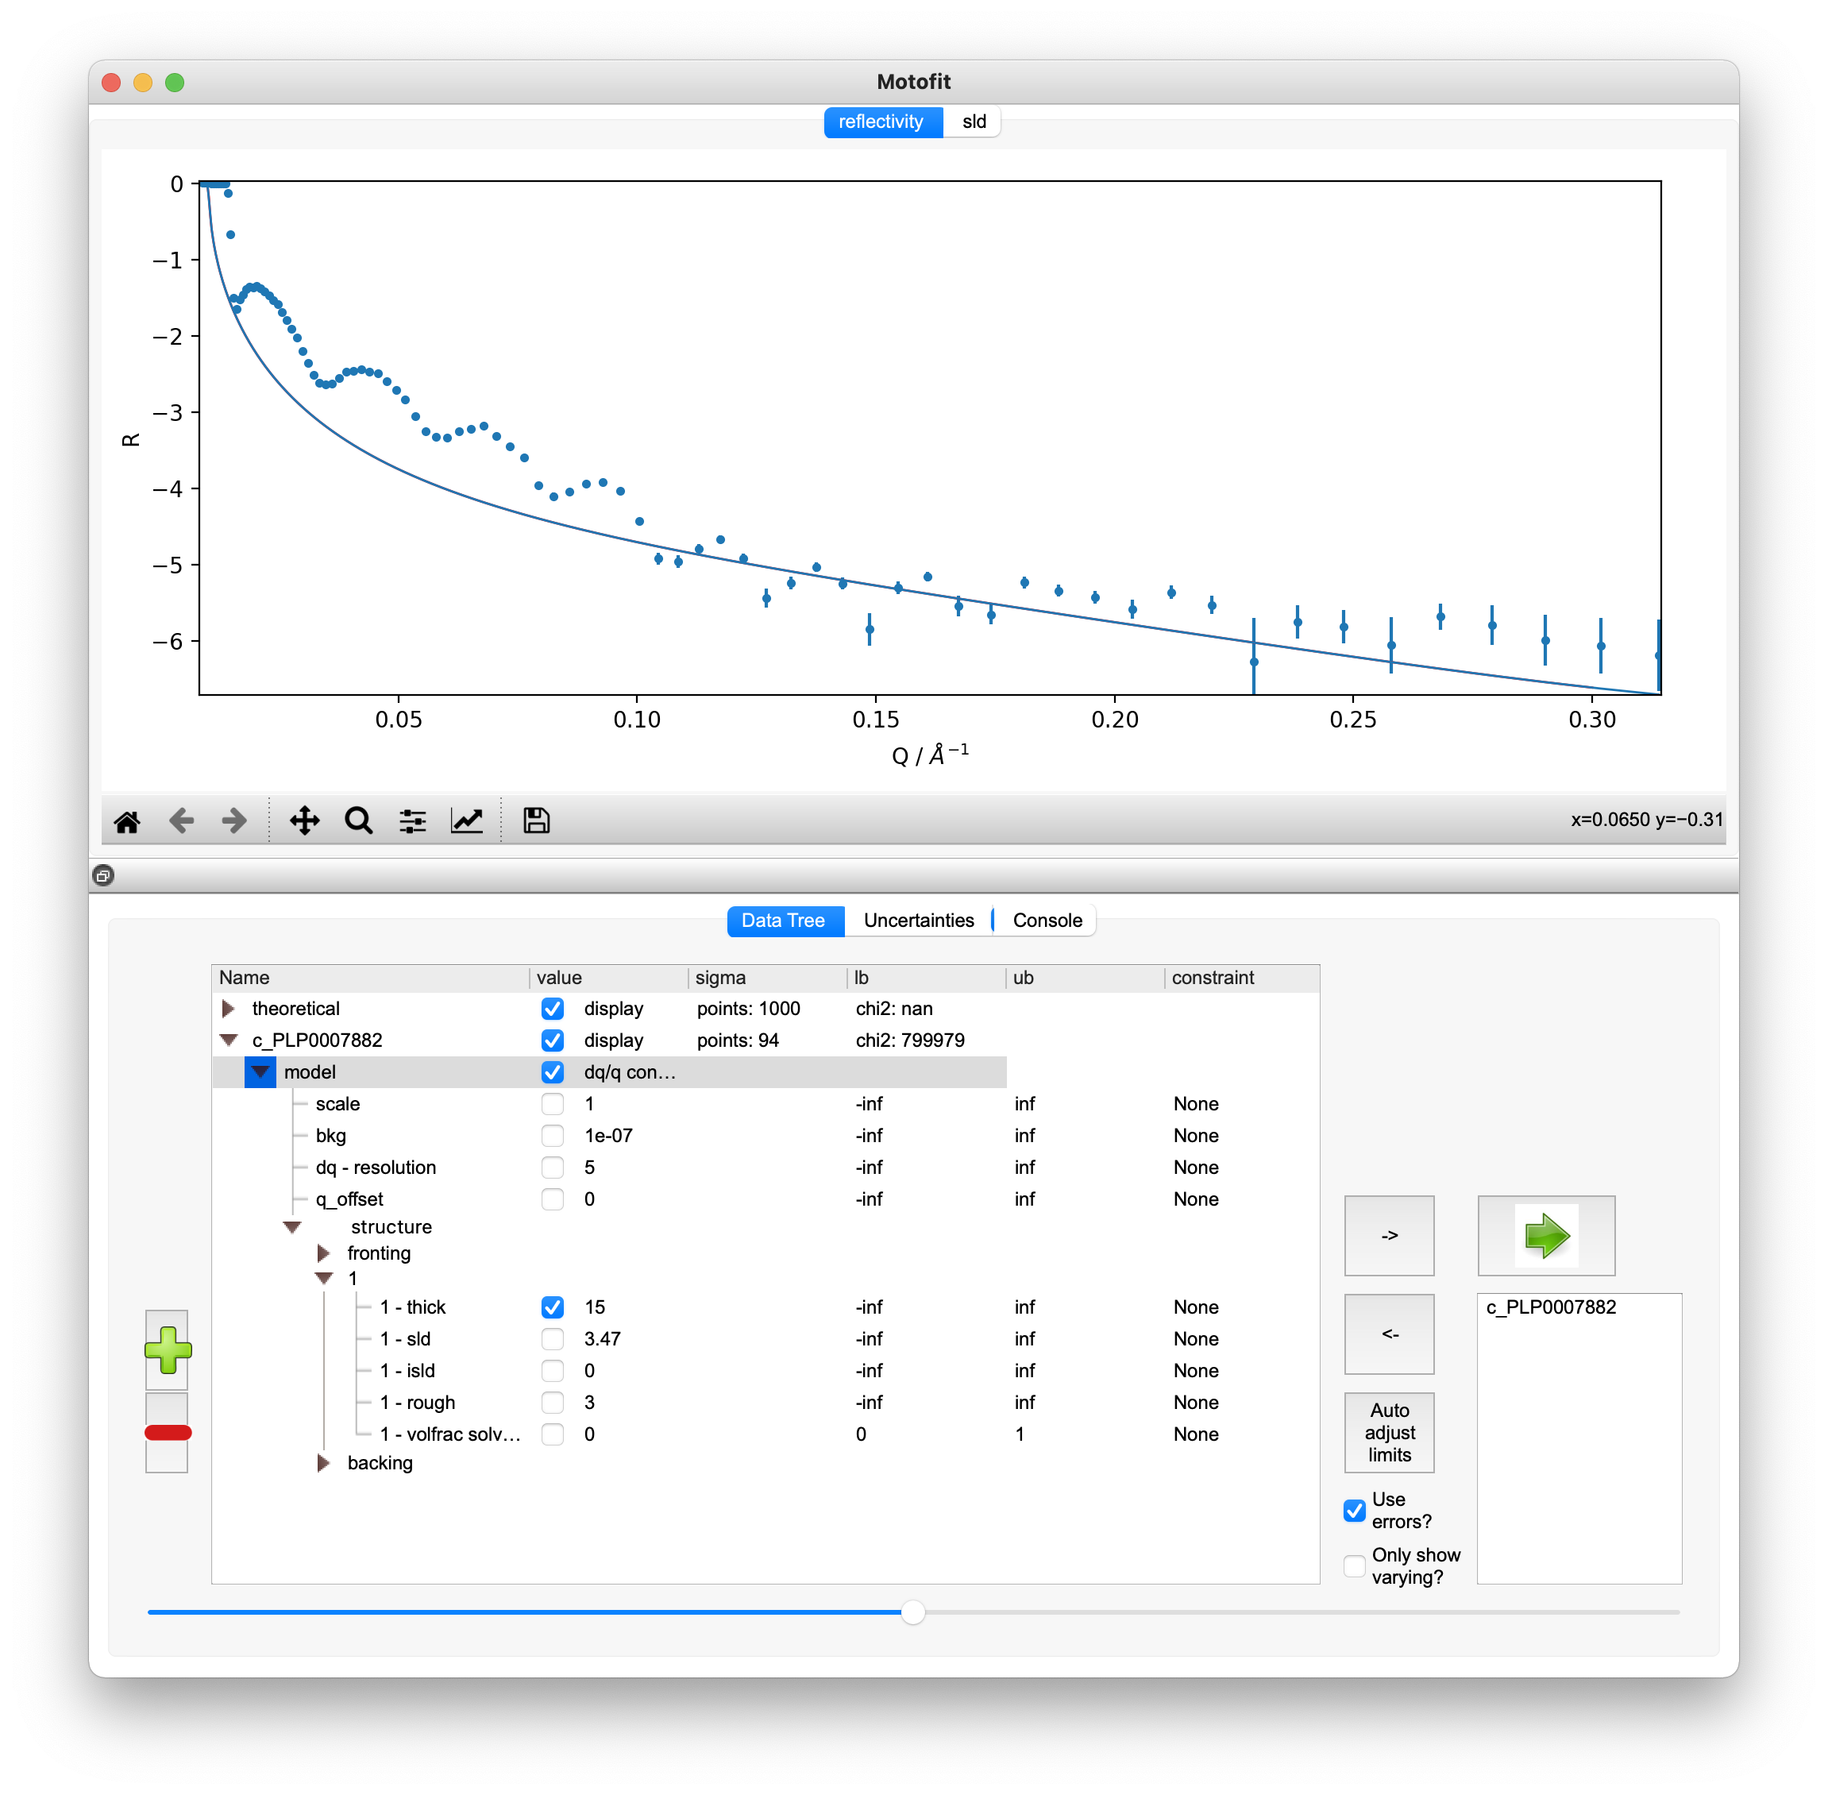
GUI
Easy way to get started
Export model to script
Co-refine datasets
Batch fitting
https://github.com/refnx/refnx/releases/latest

Slide 7
Jupyter notebook - reproducibility

Slide 8
Architecture

Slide 9
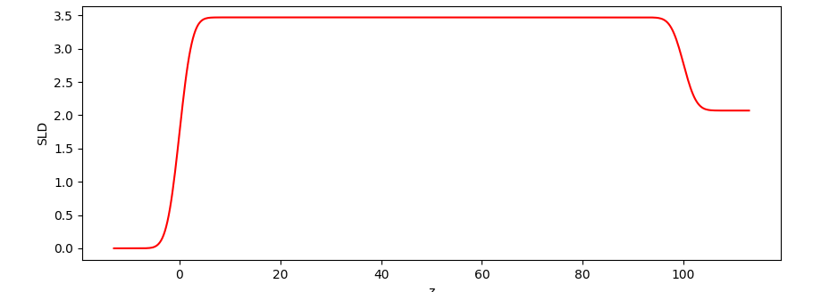
Component – describe a subset of the interface
Slab:
uniform SLD (mass density) over a given thickness, with an interfacial roughness (Nevot-Croce)
from refnx.reflect import SLD, Slab
air = SLD(0.0)
sio2 = SLD(3.47) # an SLD of 3.47 x 10⁻⁶ Å⁻²
sio2 = SLD(3.47 + 1.05e-5*1j) # an SLD of (3.47 + 1.05 x 10⁻⁵ i) x 10⁻⁶ Å⁻²
sio2_slab = sio2(100, 3) # 100 Å thick, with a roughness of 3 Å
sio2_slab = Slab(100, 3.47, 3) # equivalent to the previous line
sio2_slab.vfsolv.value = 0.5 # 50 %v/v solvation of a slab

Slide 10
Interface – transition between layers
Roughness of layer N is between N-1/N
Erf
Linear
Exponential
Tanh
Sinusoidal
Step
Examples
from refnx.reflect import Slab, Linear, Tanh
Slab(50, 3, interface=Linear())
structure.interfaces = Tanh()
structure[1].interfaces = Tanh()
Svechnikov, M. et al. Journal of Applied Crystallography, 2017, 50, 1428-1440
Stearns, D. G. J. Appl. Phys., 1989, 65, 491–506
D. Bahr; et al., Phys. Rev. B, 1993, 47 (8), 4385

Slide 11
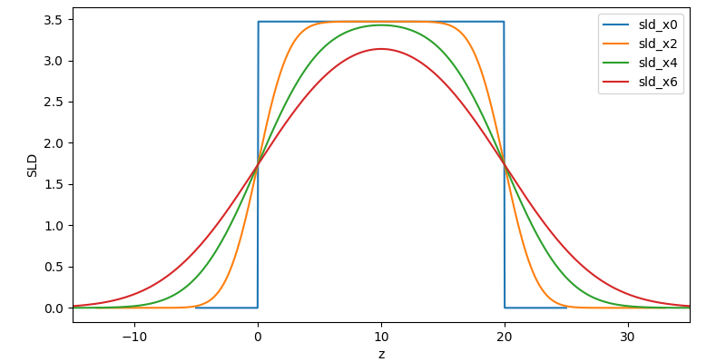
Roughness – reasonableness?

Slide 12
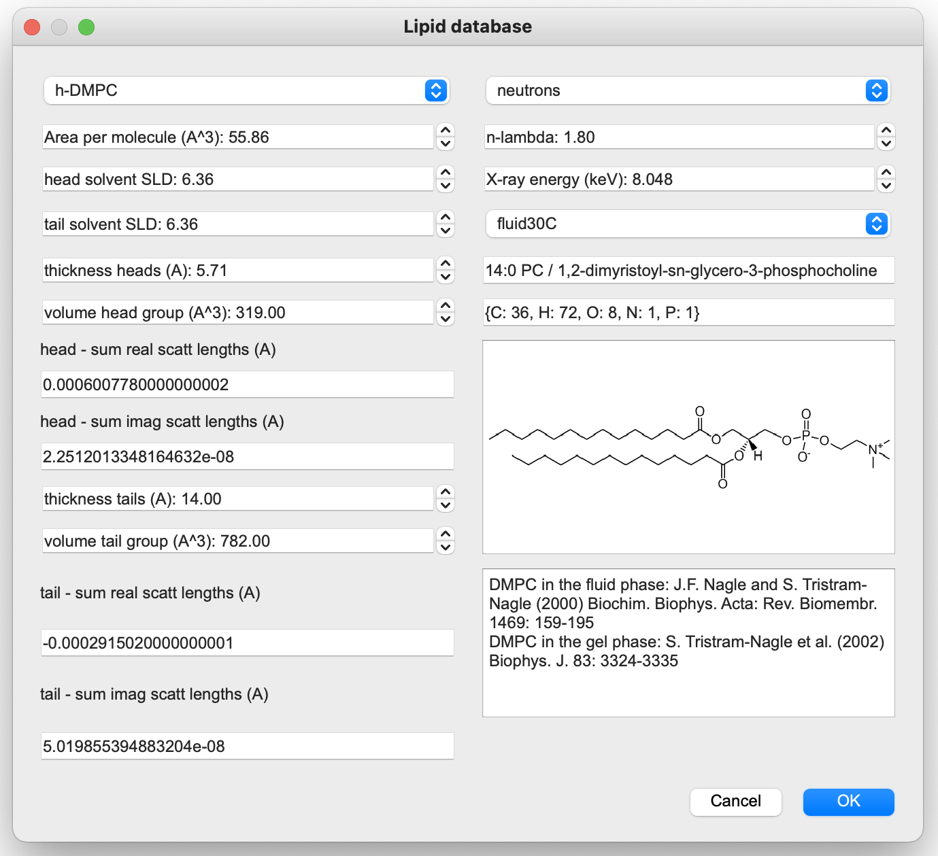
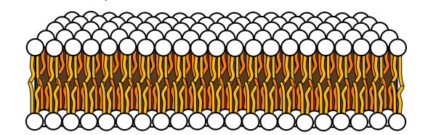
Component – describe a subset of the interface
LipidLeaflet:
Head and tail regions of an amphiphile
Area per molecule, V_{mh}, V_{mc}, b_{h}, b_{c}, t_{h}, t_{c}

Slide 13
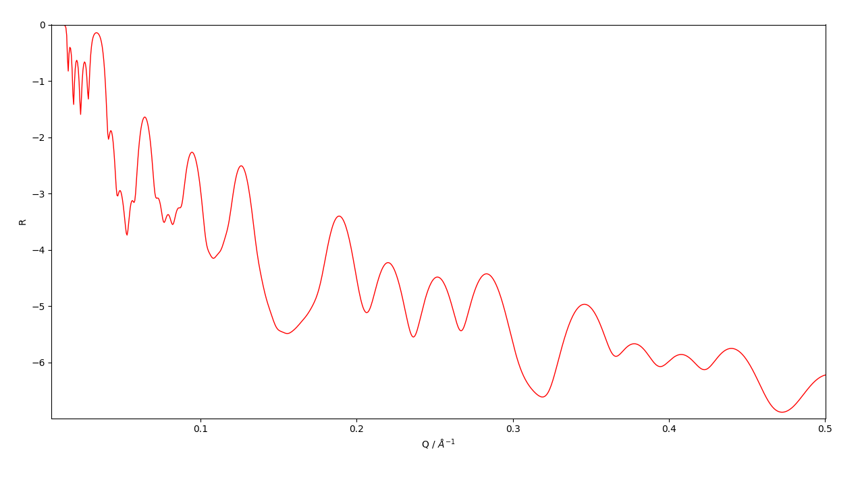
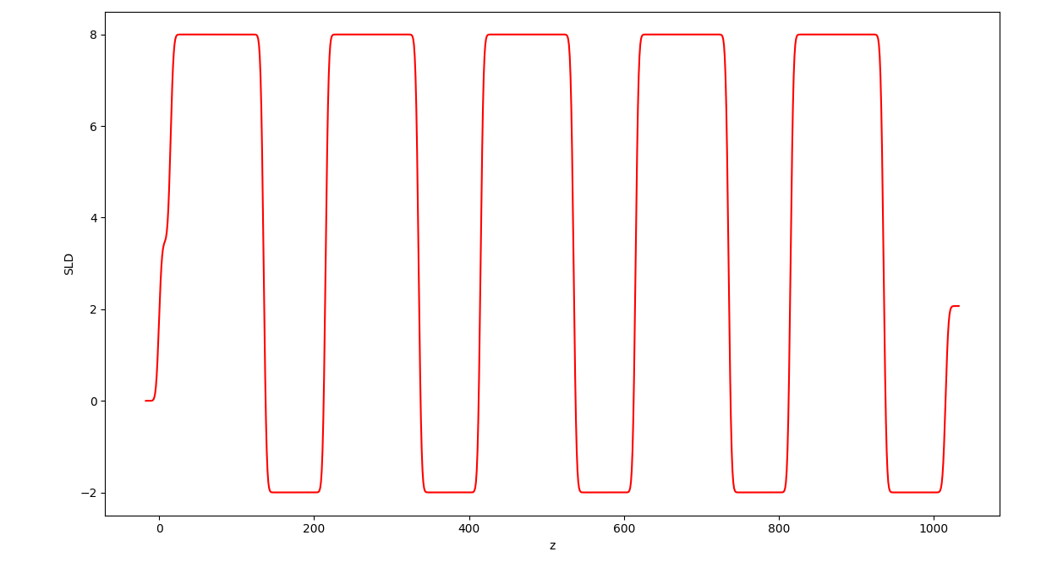
Component – describe a subset of the interface
Stack:
repeat a series of Component
from refnx.reflect import Stack
stk = Stack(components=[slab0, slab1], repeats=5)
s = air | stk | si(0, 3)

Slide 14
Component – describe a subset of the interface
MixedSlab – similar to Slab but made of two different materials
Spline – freeform profile using splines
FunctionalForm – analytic expressions to describe region
FreeformVFP – freeform spline description of a volume fraction profile (polymer brush)

Slide 15
Structure – describes the interface
A series of Component
Solvation is normally done by the last component, but is adjustable
from refnx.reflect import Structure
s = air | sio2_slab | si(np.nan, 3)
# or
structure = Structure()
structure.append(air(0, 0))
structure.append(sio2_slab)
structure.append(si(np.nan, 3))
dtol = SLD(5.9)
s.solvent = dtol
’Fronting’
’Backing’

Slide 16
ReflectModel – instrumental effects
Applies resolution smearing
pointwise (from dataset)
constant dq/q
specialised resolution kernel
Scales data
Adds background
from refnx.reflect import ReflectModel
q = np.linspace(0.01, 0.3, 101)
model = ReflectModel(structure, scale=1, bkg=1e-7, dq=5.0)
R = model(q, x_err=0.05 * q)

Slide 17
MixedReflectModel – account for patchiness
Lateral non-uniformity > neutron coherence length → average reflectivities
thickness / coverage
from refnx.reflect import MixedReflectModel
mm = MixedReflectModel([structure0, structure1])
mm.scales[0].setp(vary=True, bounds=(0, 1))
mm.scales[1].setp(vary=True, bounds=(0, 1))
mm.bkg.setp(vary=True, bounds=(1e-8, 1e-5))
https://dx.doi.org/10.1021/acs.macromol.0c02775

Slide 18
Parameter – variables in a model
Can be given Bounds, which can be any scipy.stats distribution
Use the `setp` method to change attributes
Use Parameter when setting up objects in refnx. Re-use them to make parameter linkages
from refnx.analysis import Parameter, PDF
from scipy.stats import norm
p = Parameter(value=15, vary=True, name=’thickness’, bounds=(1, 20))
dist = norm(loc=15, scale=3)
g_prior = PDF(dist)
p.setp(vary=True, bounds=g_prior)
# create a silicon layer and an oxide layer with the same thickness
sio2_layer = Slab(p, sio2, 3)
si_layer = Slab(p, si, 10)

Slide 19
Parameter
Most objects have a `parameters` attribute that lists what parameters are contained within it
Objective also have a `varying_parameters` method
Constraints between parameters
print(model.parameters)
print(objective.parameters)
print(objective.varying_parameters())
p0 = Parameter(15)
p1 = Parameter(20)
p1.constraint = 2 * p0 + np.sin(p0)

Slide 20
Objective – calculate statistics
Objective combines model and data
GlobalObjective combines multiple objectives
Methods
logl
logp
logpost
nll
chiqr
generative
residuals
varying_parameters
plot
corner
covar
from refnx.analysis import Objective
objective = Objective(model, data)

Slide 21
CurveFitter – minimisation
L-BFGS-B
Levenberg-Marquardt
Differential evolution
SHGO
Dual annealing
minimize NLL / NLPOST / Chi²
from refnx.analysis import CurveFitter
fitter = CurveFitter(objective)
fitter.fit(‘differential_evolution’)

Slide 22
CurveFitter – MCMC/nested sampling
dynesty, emcee, ptemcee, pymc3
Posterior distribution

Slide 23
A simple setup
from refnx.analysis import Objective, CurveFitter
from refnx.reflect import ReflectModel, Slab, SLD
from refnx.dataset import Data1D
data = Data1D(“mydata.txt”)
# model
si = SLD(2.07)
sio2 = SLD(3.47)
polymer = SLD(1.0)
d2o = SLD(6.36)
polymer_l = polymer(100, 4)
sio2_l = sio2(15, 3)
# create a Structure
s = si | sio2_l | polymer_l | d2o(0, 3)
model = ReflectModel(s)
sio2_l.thick.setp(vary=True, bounds=(5, 30))
sio2.real.setp(vary=True, bounds=(3, 3.5))
polymer_l.thick.setp(vary=True, bounds=(100, 200))
obj = Objective(model, data)
fitter = CurveFitter(obj)
fitter.fit(‘differential_evolution’)

